Slide 1
NEGOTIATION ANALYSIS
Presentation by: (Insert Your Name Here)

Slide 2
introduction
Negotiations can be defined as discussion aimed at reaching an agreement
Negotiation involves two parties or more
The parties deliberate on a specific or particular issue of interest
Buying and selling is a good example of negotiation where the agreement is seen when a price is agreed upon between the buyer and the seller.
For this assignment, I chose to analyze a bargaining process I engaged in while buying a laptop.
Notes:
Negotiation can be defined simply as discussion or discussions aimed at two parties reaching an agreement (Rojot, 2016). This means that in any negotiation, there have to be at least two parties involved. By parties here it means people, organizations, companies or business that engage in discussions over a particular or specific issue seeking to reach an agreement or compromise. The two or more parties engage in discussions which involve sharing their views or presenting their side of the issue for the other side to deliberate over and vice versa and in the end, an agreement is reached where the two parties agree on particular terms or particular issues that had been deliberated on. In life situations, negotiations happen in many situations. A good example is when one goes to a market place to buy an item whose price is not fixed. The person wanting to buy or simply the buyer can engage the seller in negotiation over the price of the item. As a result, for the negotiation, the two parties, the seller of the item and the buyer of the item, reach and agreement and exchange commodity for money. Therefore, this paper is a negotiation analysis that presents an experience that I have had in a negotiation situation and incorporates concepts learned from the textbook and the class to present an overview of how the negotiation went down and what I gained from it as well as the factors that affected it and how I perceived others in the negotiation process.

Slide 3
Analysis of the negotiation situation and experiences
In a buying an selling situation that I found my self in, negotiation began when we asked the price of a HP Spectre laptop
The negotiation mainly involved bargaining the price.
Bargaining process in the negotiation helped us to eventually buy the laptop at a price lower than the initial price of $1200
Therefore, the negotiation mainly involved discussing and agreeing on the price as well as the brand of a laptop computer.

Slide 4
Control of the negotiation
In this situation, no one controlled the negotiation.
Two approaches used in the negotiation process were compromise and collaborative strategies.
As we bargained, we had to be ready to add money and the seller also had to be ready to go down on his price to help us reach an agreement of the price and computer brand.
Notes:
In this negotiation situations, no one controlled the negotiation. Instead, we applied a compromise style of negotiation. A compromise style of negotiation where all parties in negotiation are willing to compromise and loose for the sake of reaching an agreement with each other (Mircică, 2014). In this style of negotiation, parties have to be collaborative in the sense that they both win and lose to arrive at an agreement. In this case, the money we had was lower than what the seller wanted for the laptop and therefore, we have to compromise and add more money but the seller also had to compromise and lowered his price from the initial $1200 price that he told us the first time we asked the price. After bargaining and negotiating with the seller, we were faced with two choices which were to add the amount to $1000 or buy a computer with lesser specifications and characteristics as compared to HP Spectre.

Slide 5
Factors that affected the negotiation
In this buying and selling negotiation situation, certain factors affected the process
Financial situation in January was one factor
The lack of a competing computer shop or store in the neighbourhood also affected the negotiation in the sense that it was not easy to baragain.
Notes:
Some of the factors that affected the negotiation process include the lack of competing seller in the neighbourhood. There was no other computer seller within a radius of 5 kilometers from the local computer store. Therefore, this affected the bargaining process because the seller had little to worry about us going out of his shop without buying to try another seller. Furthermore, our limited knowledge of computer systems and functionalities also affected the negotiation process in this situation. However, of most importance is the economic situation at the time we were trying to buy the computer. January is always a hard time for many people due to the fact that a lot of resources are spent in late December and early January because of both the Christmas and New Year celebrations and therefore, engaging in an activity such as purchasing a computer is strenuous to most people. This is because there is very little left to spend after celebrations. This is what made us to engage in intense bargaining of the price of the computer. These prevailing financial conditions was a key factor in affecting the negation process in this situation.

Slide 6
What I learned about myself
From the negotiation situation, the main thing I learned was that empathy is key in negotiation
I realized that I was willing to see the situation from the perspective of the seller
Empathy made me realize that I am easy to negotiate with and it is easier to reach an agreement with me in a negotiation process.
Notes:
From this experience, I learned something about myself. I realized that I was empathetic. In my negotiations with the computer seller at the shop, I suggested my price but as I listened to John explaining the reason why he had to sell the computer at not less than $1000, I empathized with him and saw the need for me to give him the money that he was asking for the laptop. Therefore, this experience made me learn that I am easier to negotiate with because I am always willing to compromise and I am always ready to see things from the perspective of others and this helps me to reach agreements easily with those I engage in a negotiation with. This is a plus for me because it also creates an effect on the people I negotiate with and they learn to empathize with me too.

Slide 7
What I learned about experiences of others
I realized that parties in negotiation only become wiling to compromise when the other part shows signs of reaching a compromise.
When both parties in a negotiation become willing to loose partly or share the wins in a negotiation, it becomes easier to reach an agreement.
Notes:
From the experience in this negotiation situation, I realized just like Patton & Balakrishnan (2012) state, that others are always willing to reach an agreement if they see that the other party in a negotiation is also willing to reach a compromise. While we were bargaining the price, I realized that the moment I told John that I could pay more than the initial $850, he too gave me a lower price from his initial $1200 for the laptop. That shows that in a negotiation process, experiences of how the other one as a party in negotiation approaches the negotiation and gestures of one person as a party in a negotiation situation determines the ease or difficulty in reaching an agreement in the discussion (Morley & Stephenson, 2015). As such, I will use concepts such as collaborative and compromise negotiations in my negotiation because this brings the sense of willingness to lose or allow the other party to win too for the sake of reaching an agreement.

Slide 8
What I would do differently
Based on the contents of the course and text, I would not disclose the amount am willing to spend in a buying and selling negotiation situation.
Instead, I would ask the seller to give the prices of various brands and try to negotiate without mentioning the amount.
This will hep to avoid rigidity on the side of the seller.
Notes:
Based on the contents of this course and the textbook, I would do this negotiation differently. This is because that every negotiation situation calls for a unique negotiation style that can help the parties involved to reach an agreement. The one thing that I would have done differently was not to reveal to the seller the amount of money that I was willing to pay for the laptop. This way, I would engage in asking the price and trying to negotiate to a lower price without necessarily mentioning the amount I was willing to spend on purchasing a laptop. Not mentioning the price would have been crucial in ensuring that the seller would be willing to negotiate the price without having a formed stance on the amount of money he can take having already had how much I was willing to spend.

Slide 9
Lesson learned about bargaining and conflict
The most important lesson I learned about bargaining and conflict is that in a buying and selling situation, when a seller is willing to bargain the price of the goods being sold, there is a high chance of reaching an agreement with the buyer.
The vice versa is true in situations where a buyer remains rigid with the price and shows no sign of lowering the price in a negotiation process.
Being rigid and fixated on the price can only create a conflict and the negotiation may not witness an agreement which is shown when the buyer and seller exchange money for goods and goods for money.
Notes:
One thing I learned about bargaining and conflict is that a bargaining process is easier to handle if the buyer is willing to lower the price. In a situation where the buyer is fixated on the initial price, it becomes demoralizing to the buyer and the buyer can easily give up and fail to but the commodity needed. Being fixated on a price can create conflict instead of an agreement and the exchange of money for a product might not be done. Therefore, a buying and selling situations, it is always easier to allow bargaining, especially for electronic devices. This allows parties to compromise and strike a deal.

Slide 10
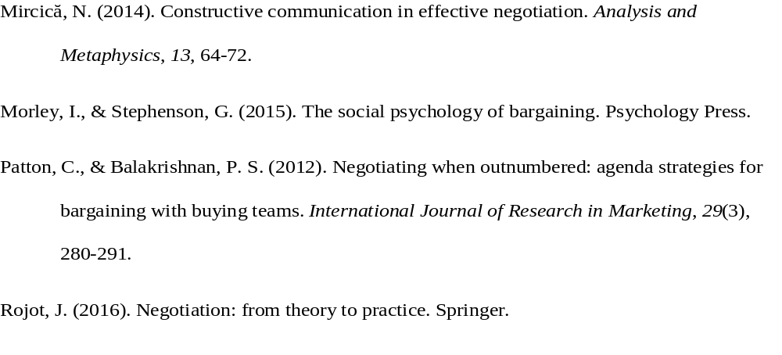
References

